Slide 1
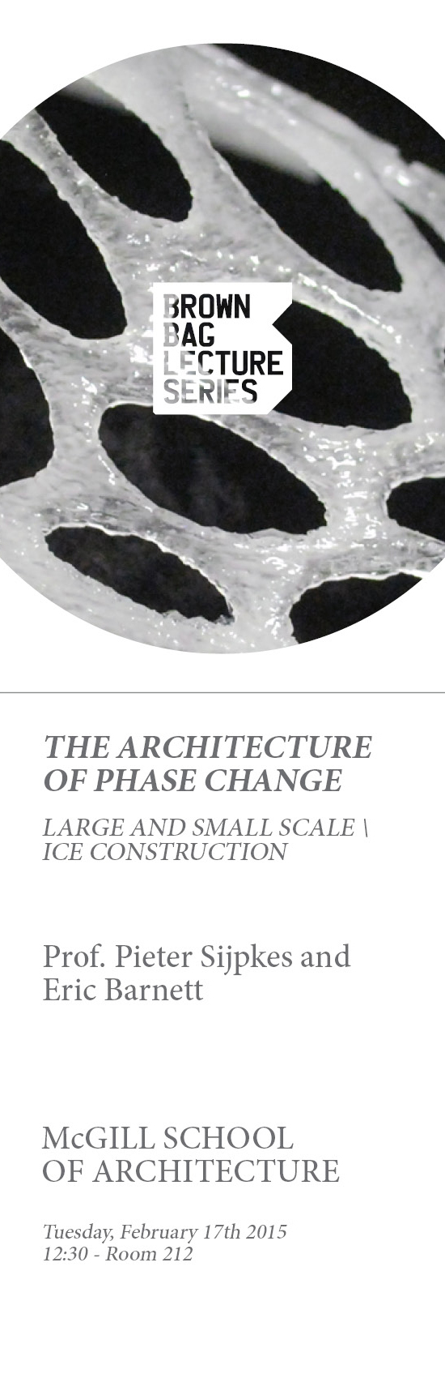

Slide 2
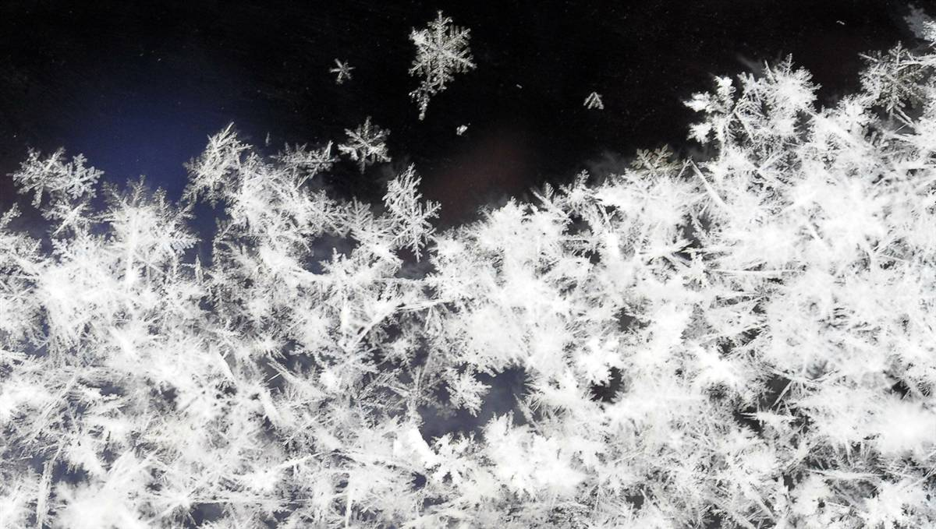
A presentation in two parts:
1. Pieter Sijpkes will talk about:
An overiew of ‘outdoor’ ice construction in history, including some large scale experiments at McGill Campus
2.Eric Barnett will talk about
Pioneering work done at McGill using laboratory-based small scale ice rapid prototyping, a product of collaboration between the School of Architecture ( Prof. Pieter Sijpkes) and the Dept. of Mechanical engineering ( Prof. Jorge Angeles), most of the research and development executed by Eric Barnett (PhD), now a post doc at Laval University.

Slide 3
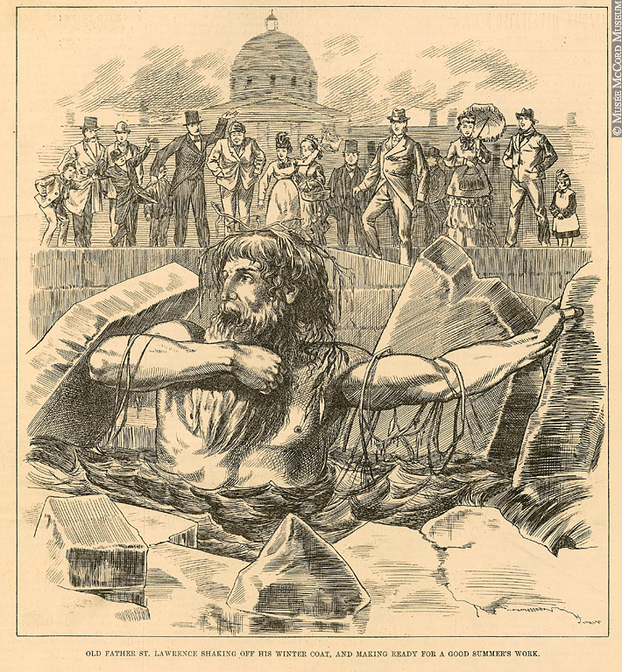
Ice as a barrier to movement and as a ‘Mindset’

Slide 4
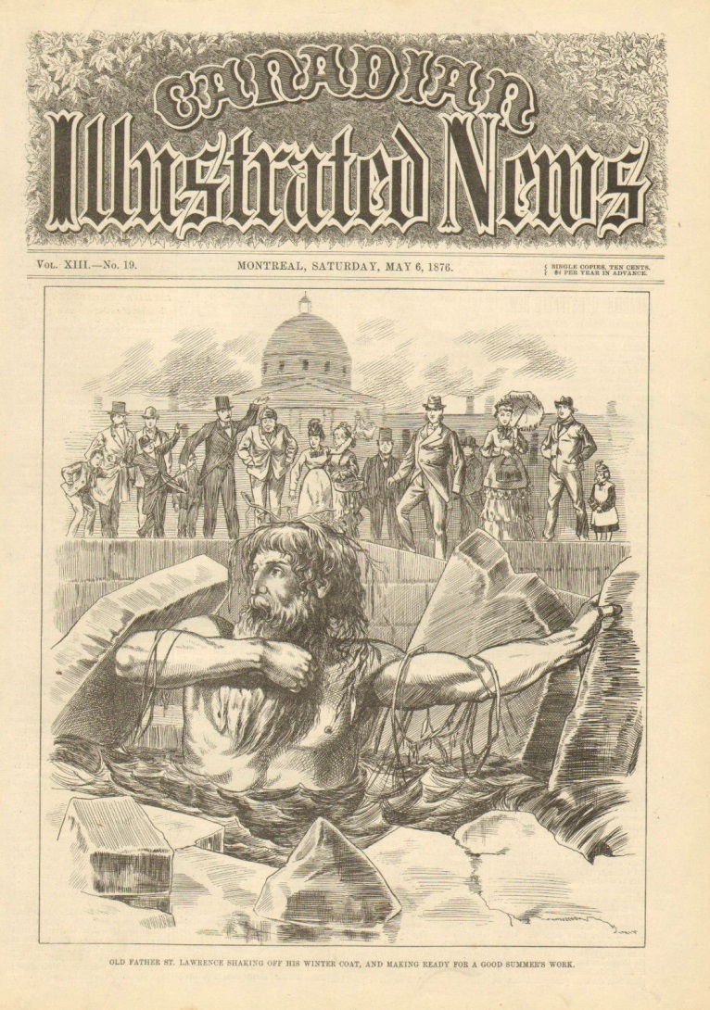

Slide 5
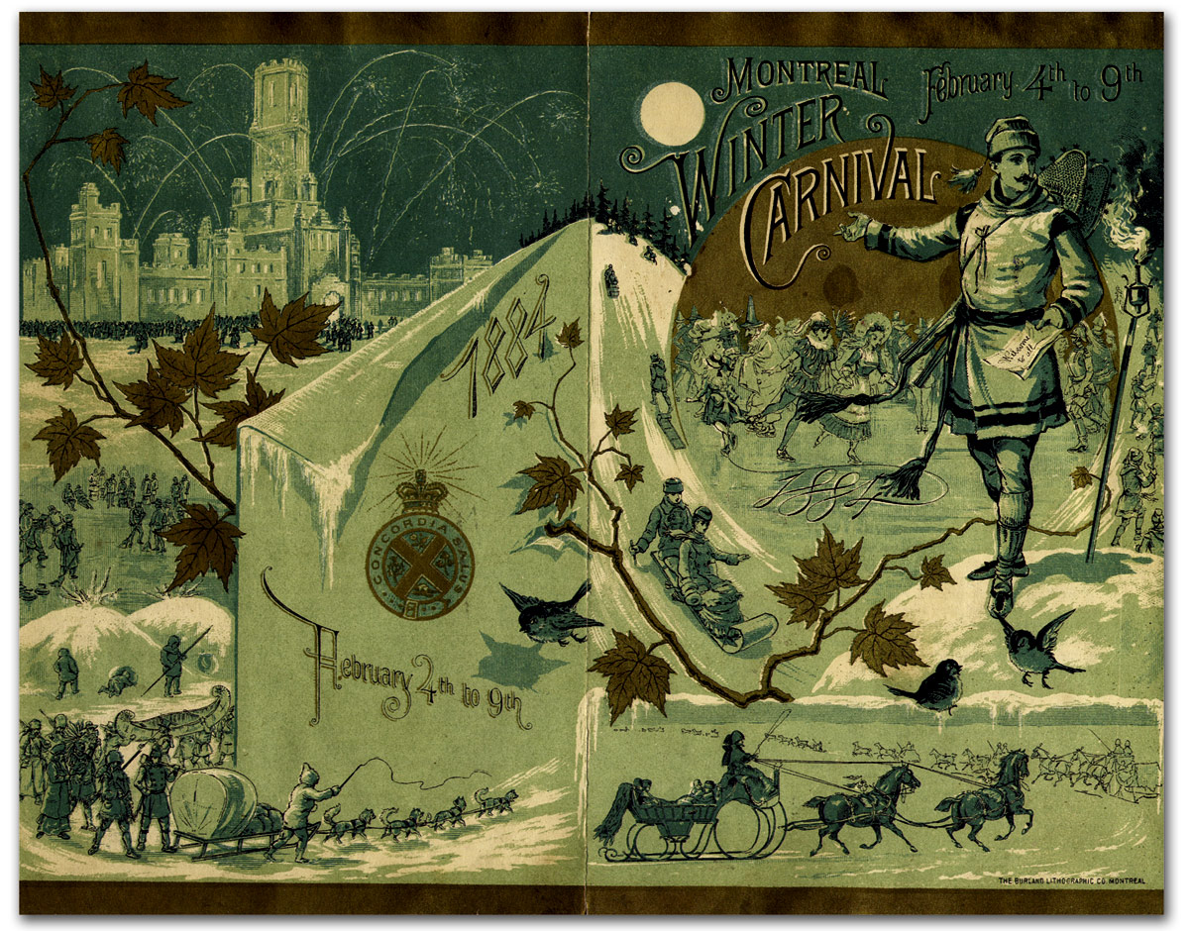
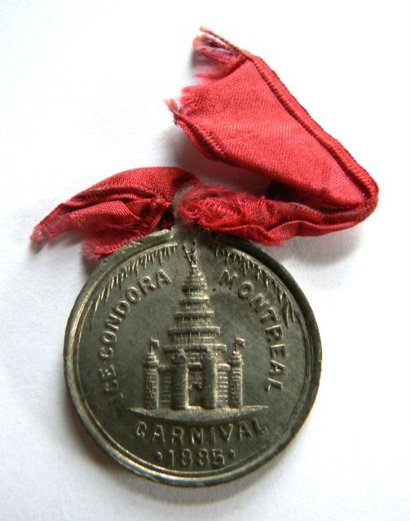

Slide 6
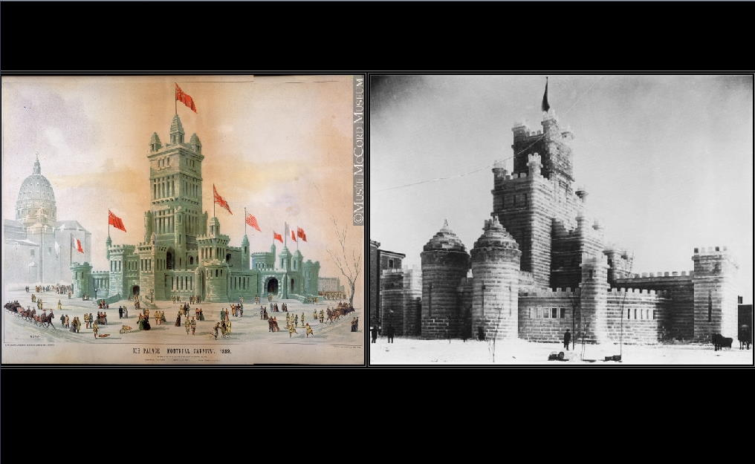
Ice Palace Dominion square 1887 made with ice cut from the St. Lawrence

Slide 7
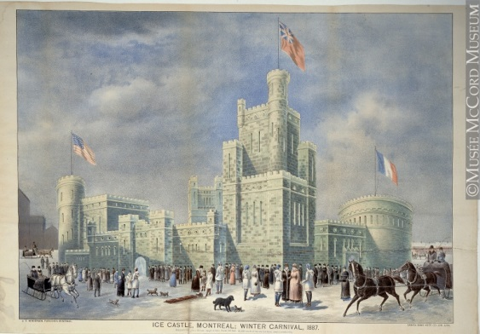

Slide 8
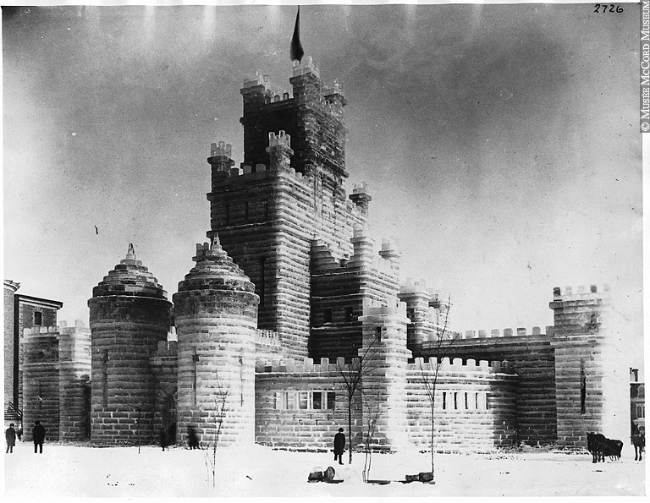

Slide 9
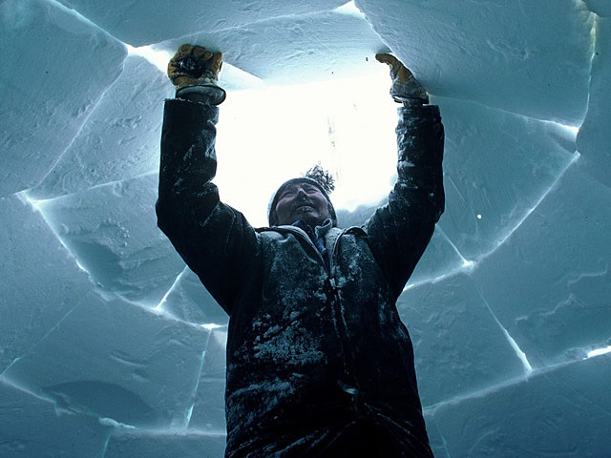
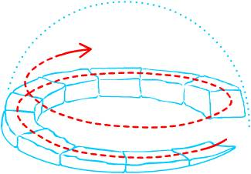
Snow as a building material for habitaton

Slide 10
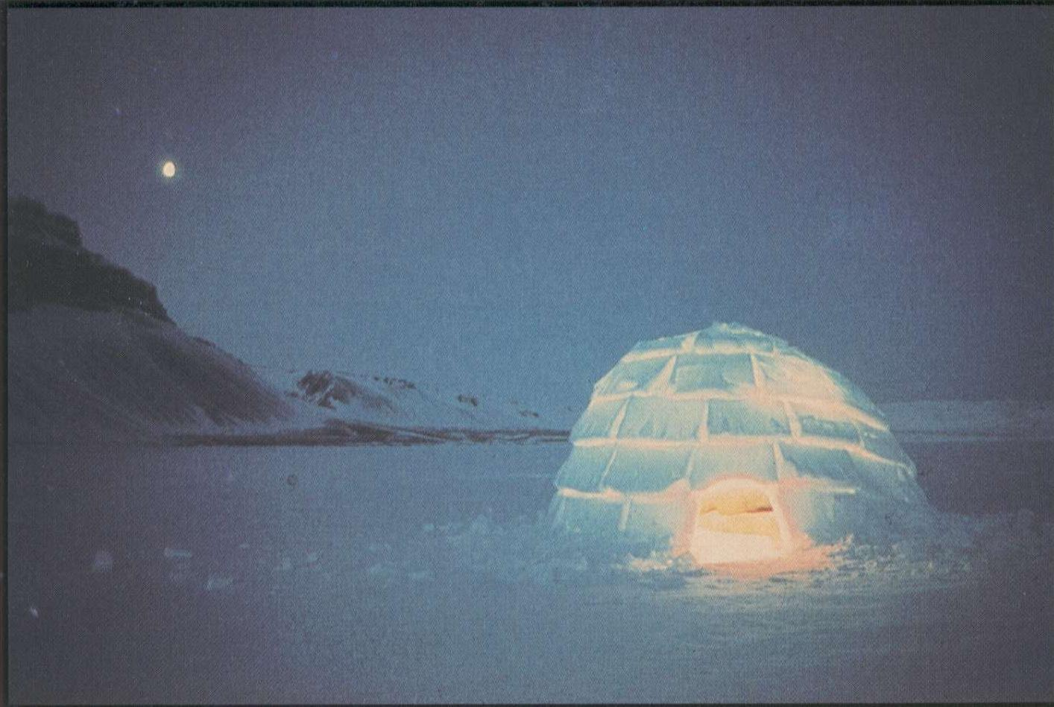
Instead of ‘primitive’, we should call this kind of dwelling highly optimized!

Slide 11

There’s a lot of sustainability , structure and thermodynamics evident in this structure.

Slide 12
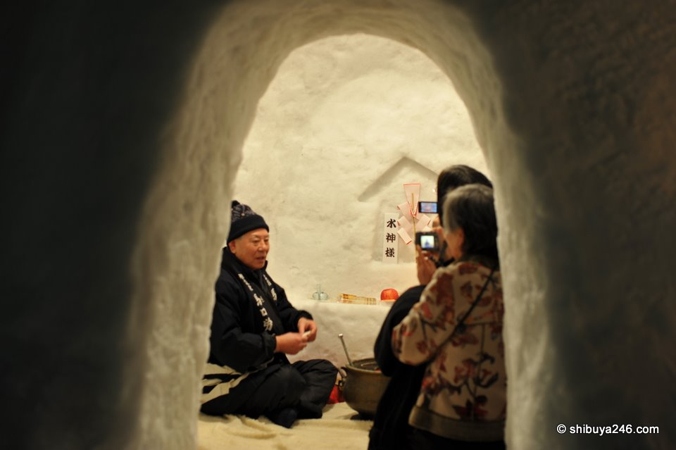

Slide 13
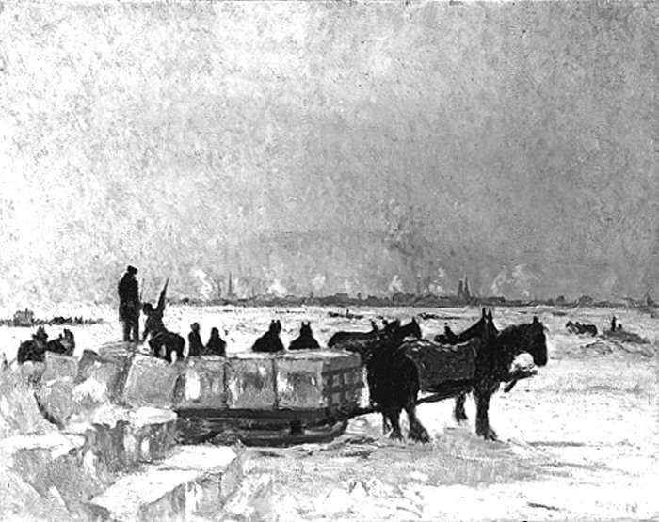

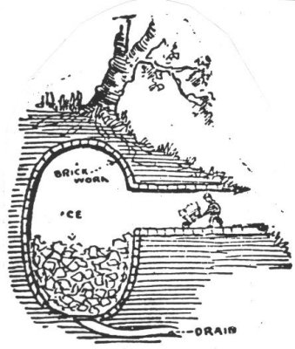
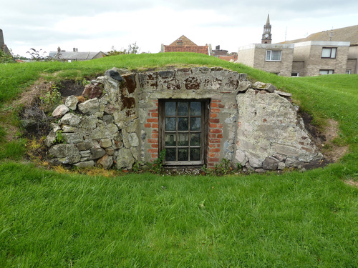
I

Slide 14
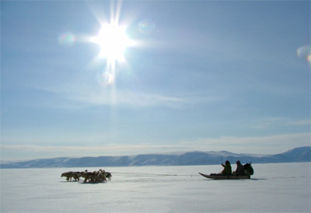
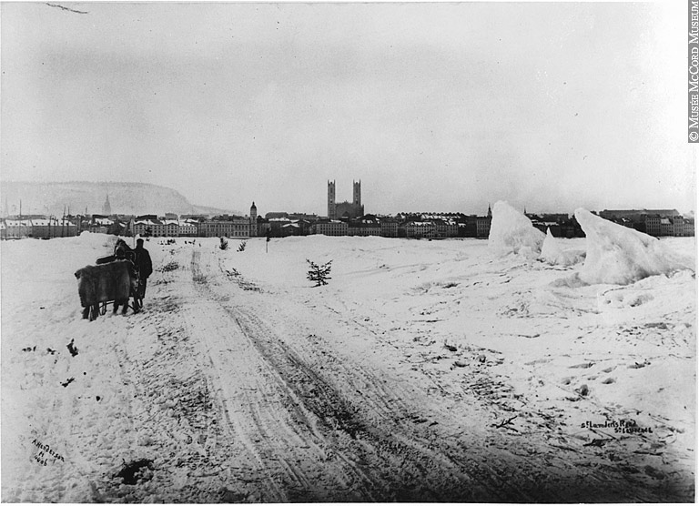
Ice as a transportation route

Slide 15
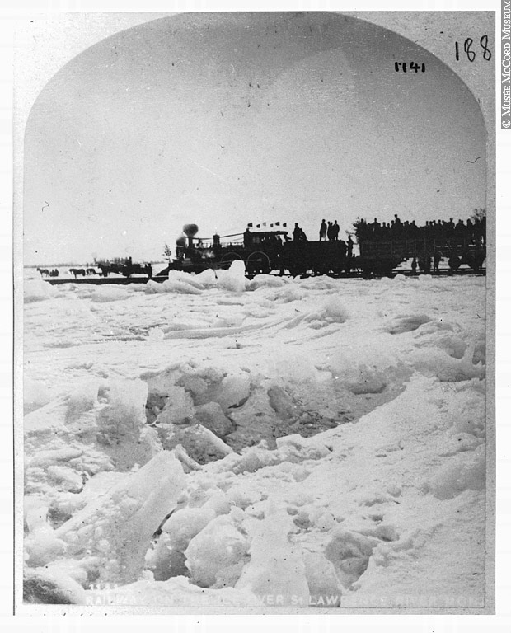
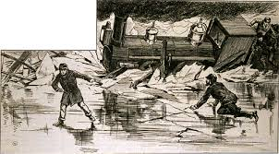
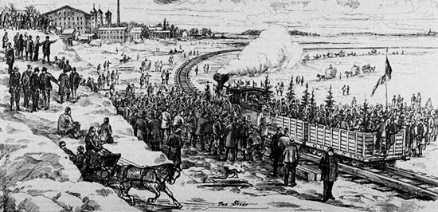

Slide 16
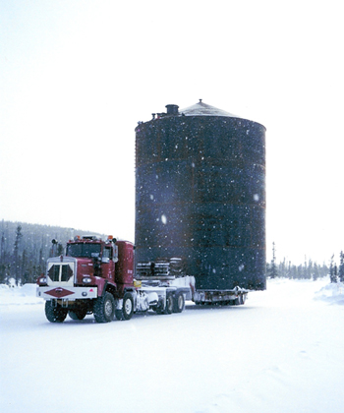

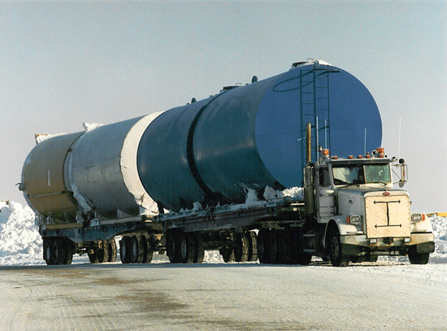
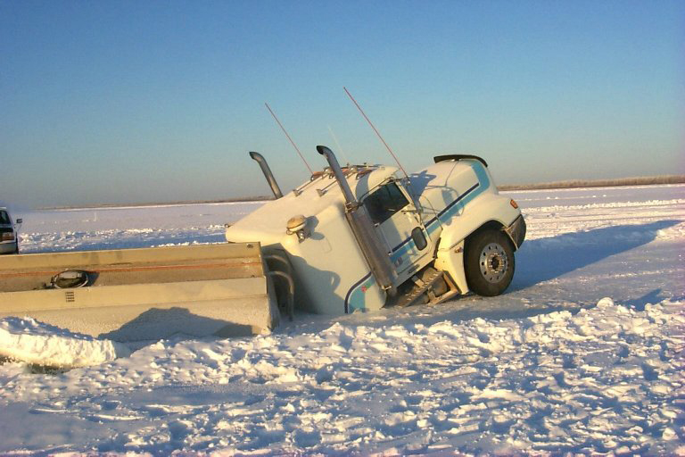

Slide 17
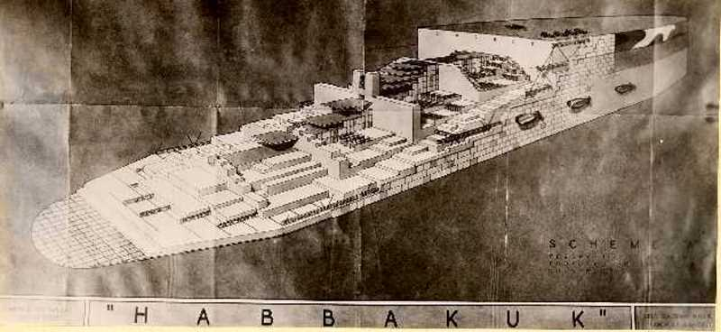
Reinforced ice, ‘pykrete’, used as material for mammoth aircraft carriers

Slide 18
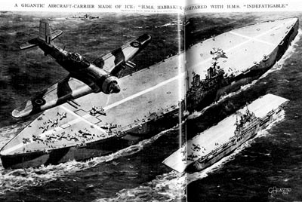
Project Habakkuk proposed during WWII: Based on the use of Pykrete: a composite material made of frozen water mixed with sawdust

Slide 19
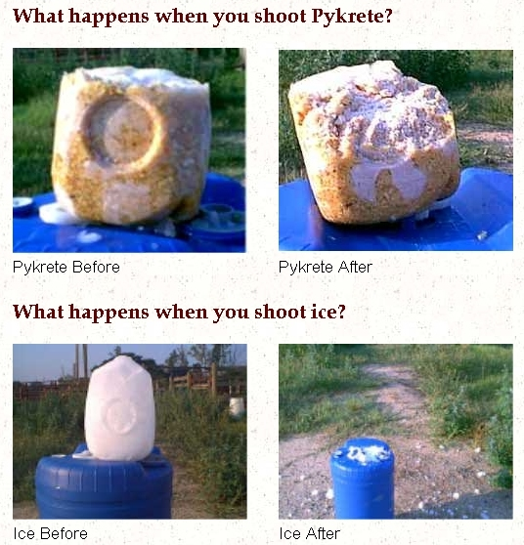

Slide 20
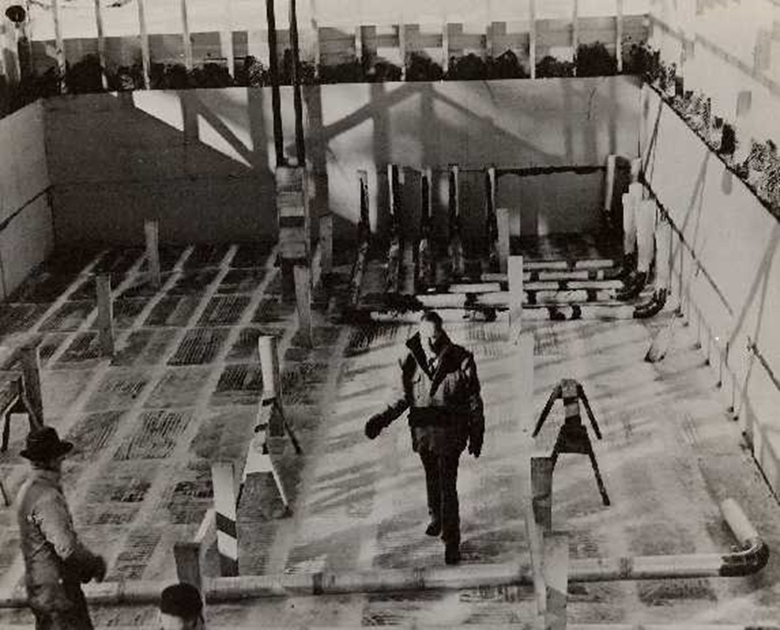
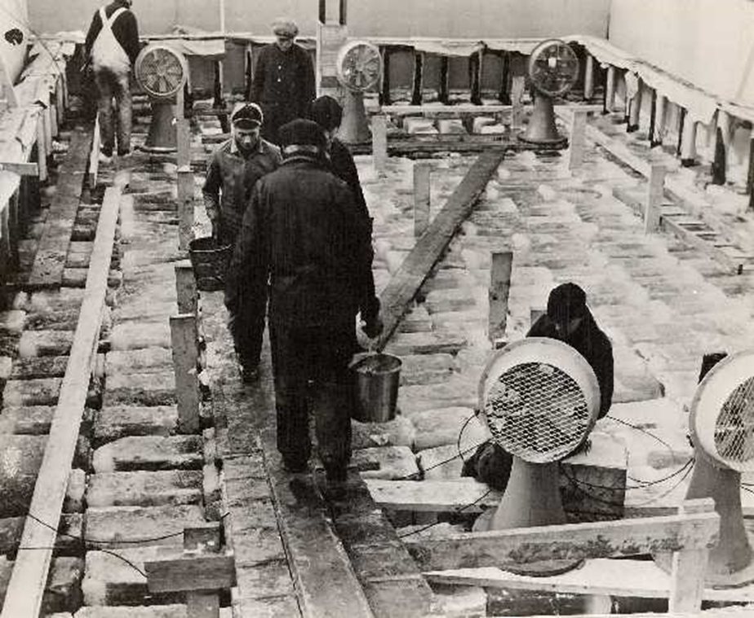
At a secret locations in Alberta..1944

Slide 21
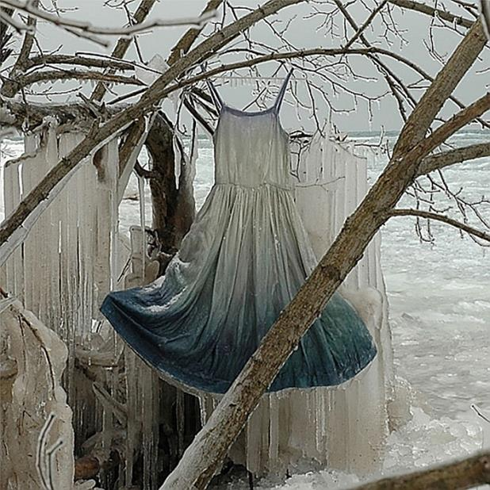
Fabric-reinforced ice

Slide 22
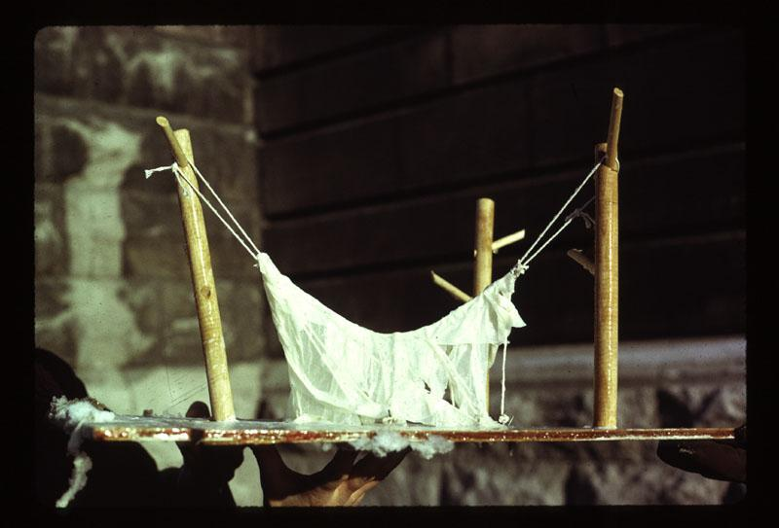
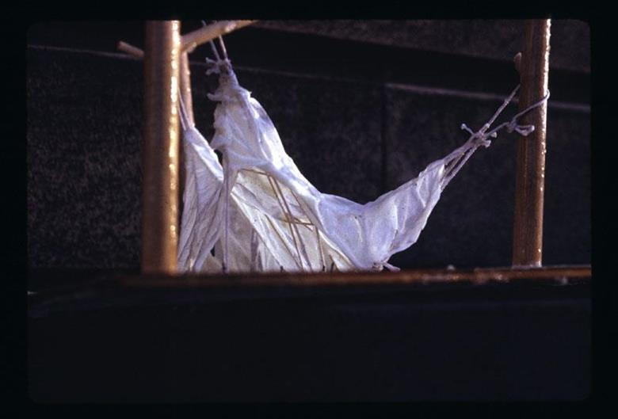
A model

Slide 23
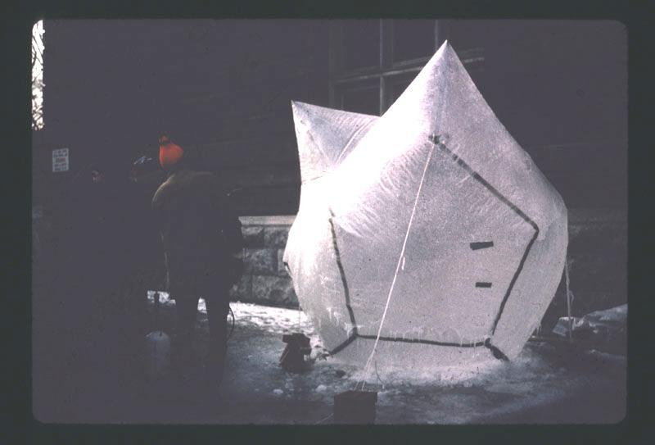
Inflatable form..

Slide 24
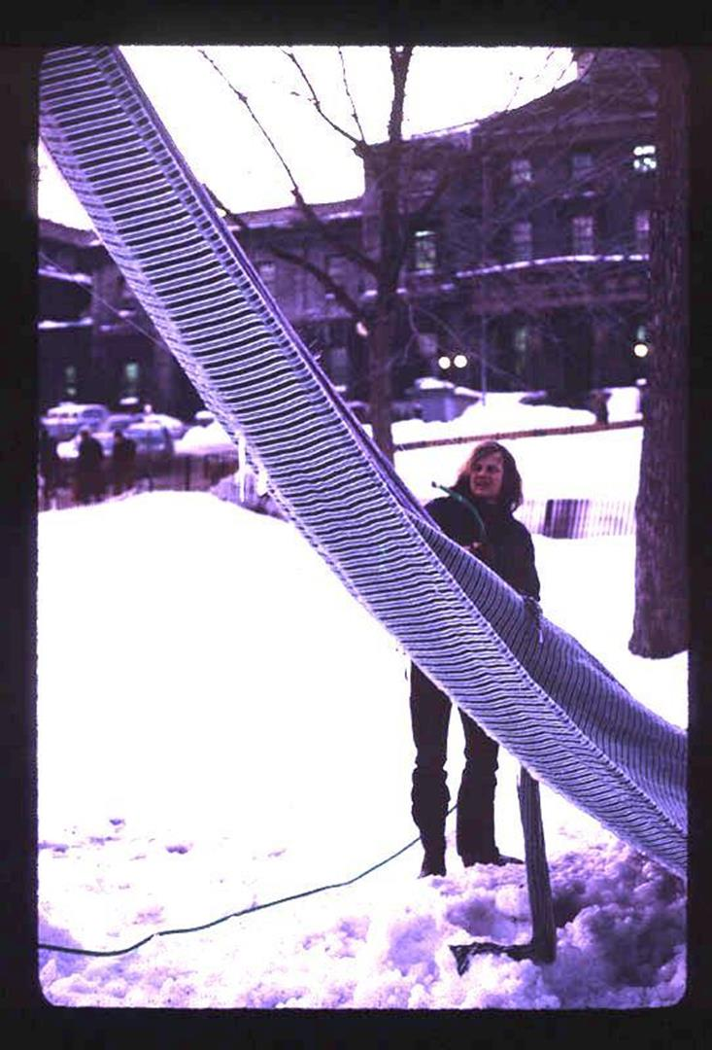

Slide 25
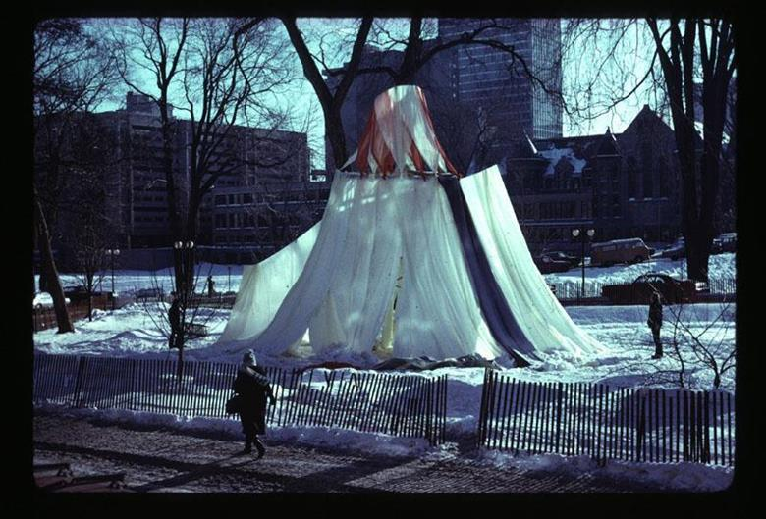

Slide 26
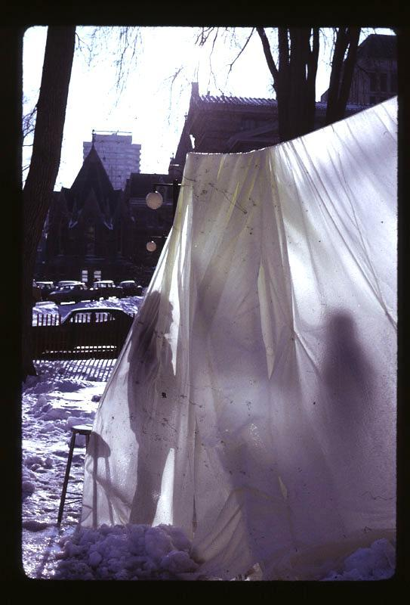
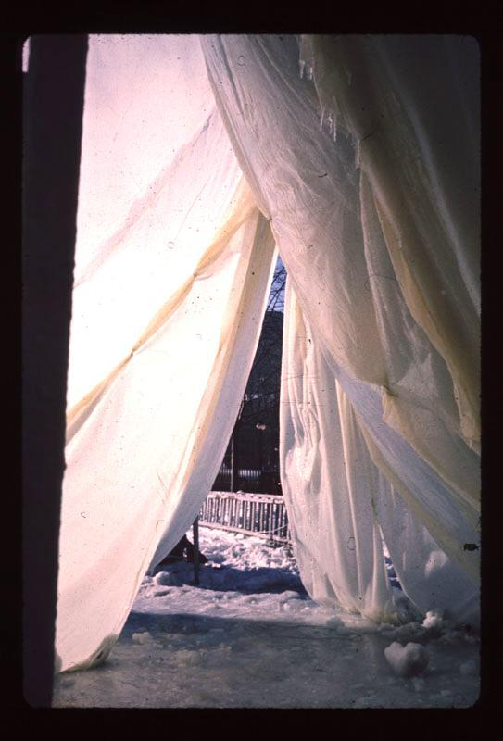
Notes:
Something to be learned, structurally, from the ice built-up and the ice-loss

Slide 27
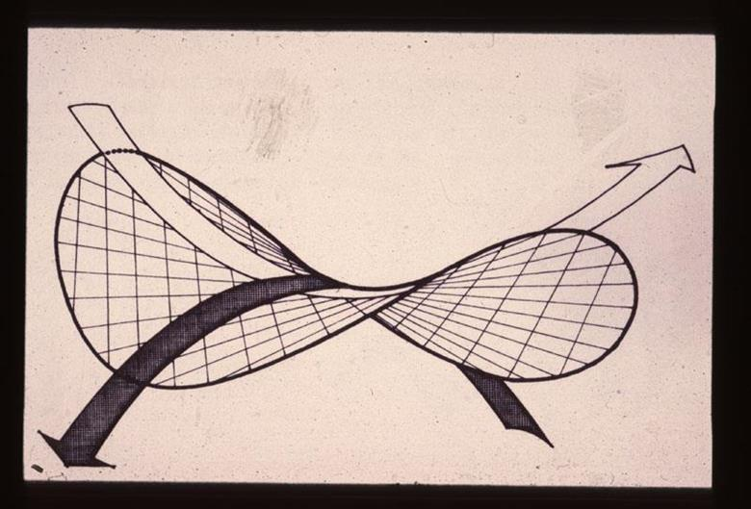
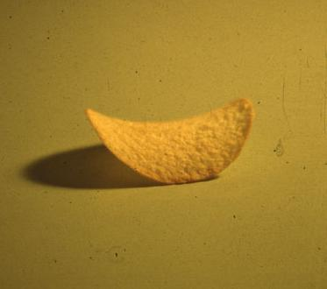

Slide 28
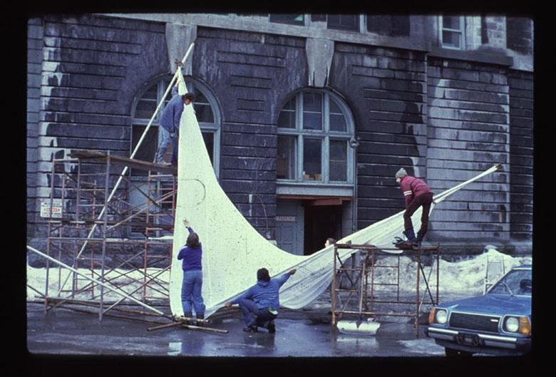
Test section close to the school

Slide 29
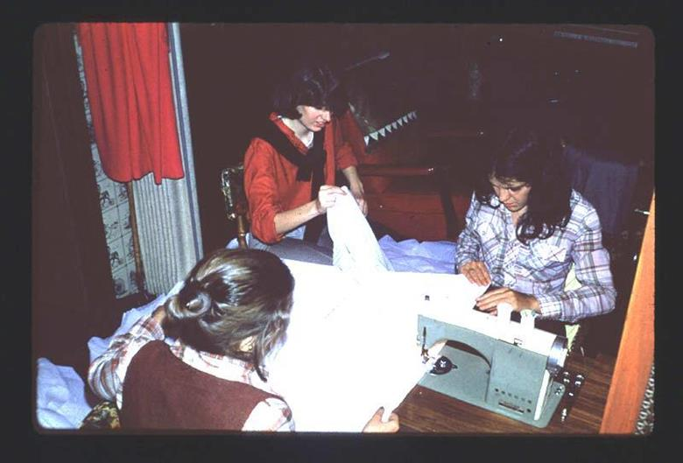
Sewing the sheets together

Slide 30
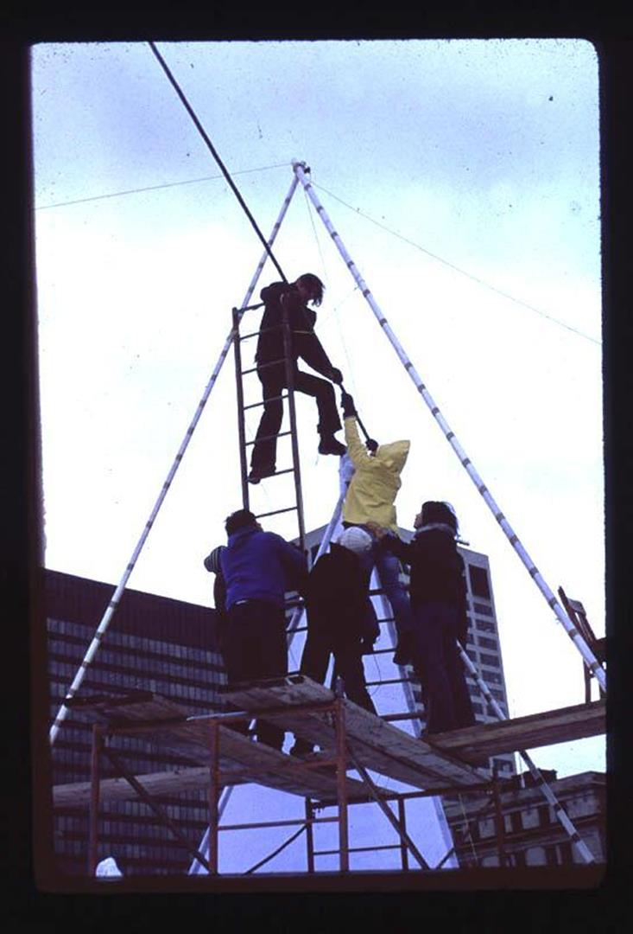

Slide 31
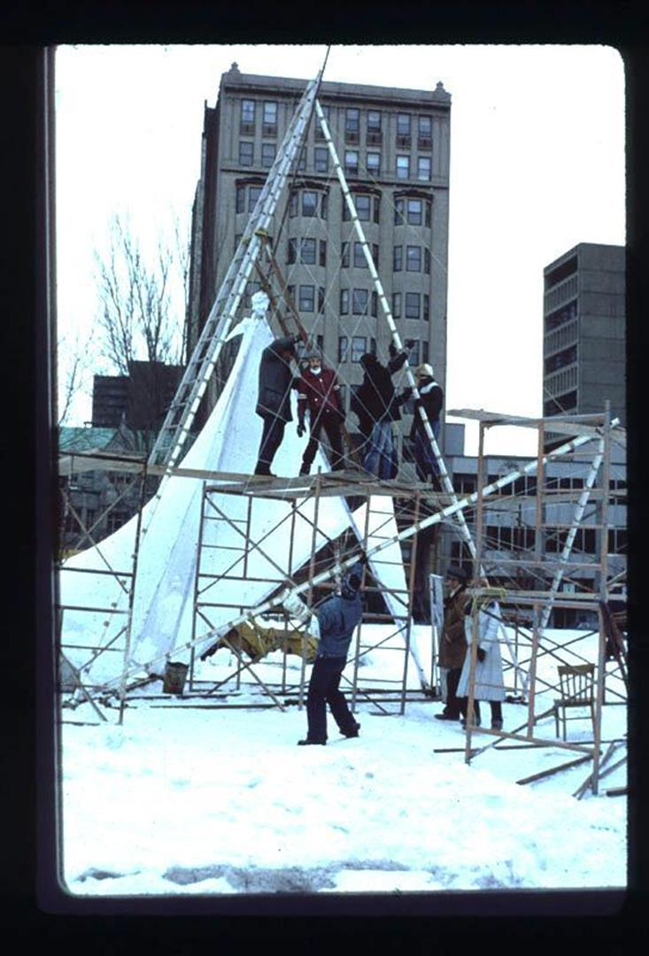

Slide 32
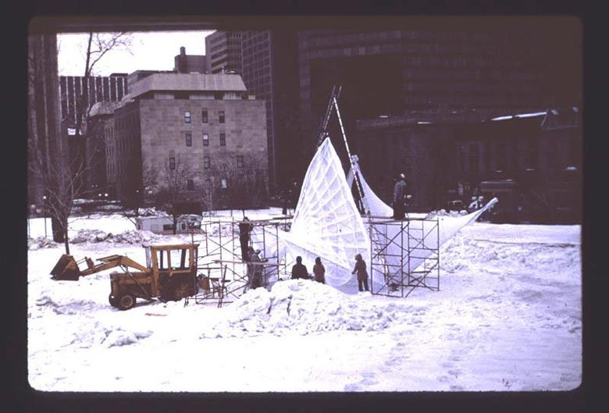

Slide 33
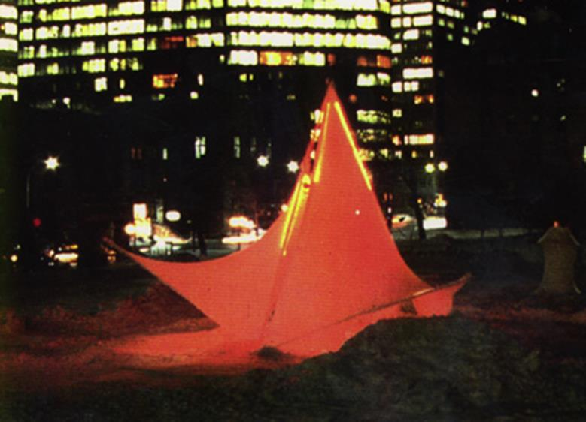

Slide 34
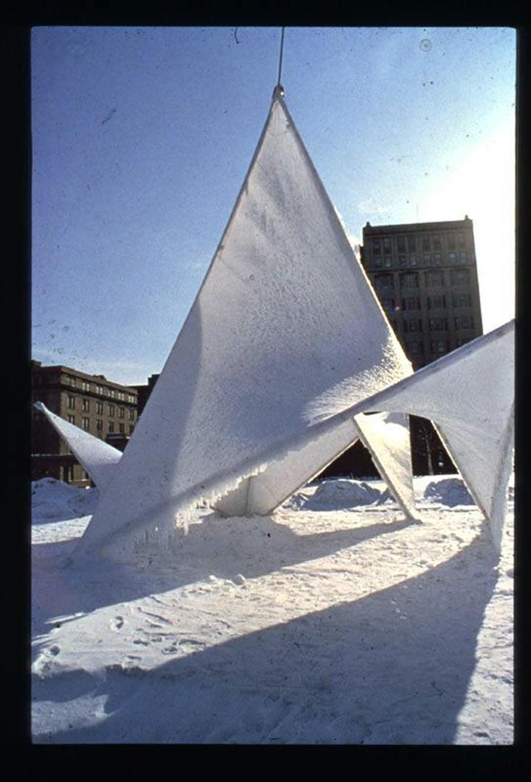

Slide 35
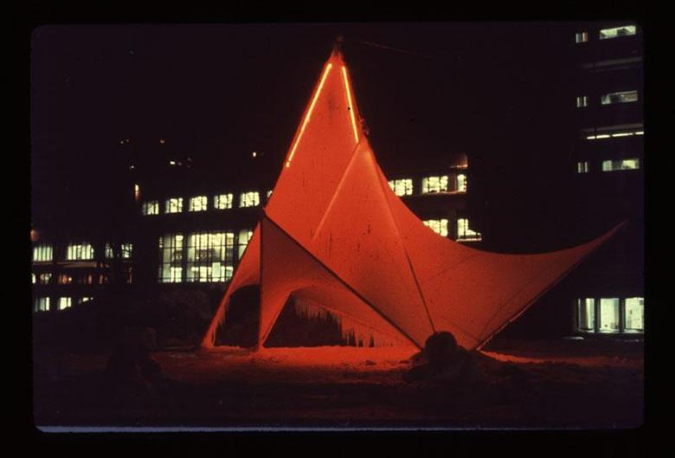

Slide 36
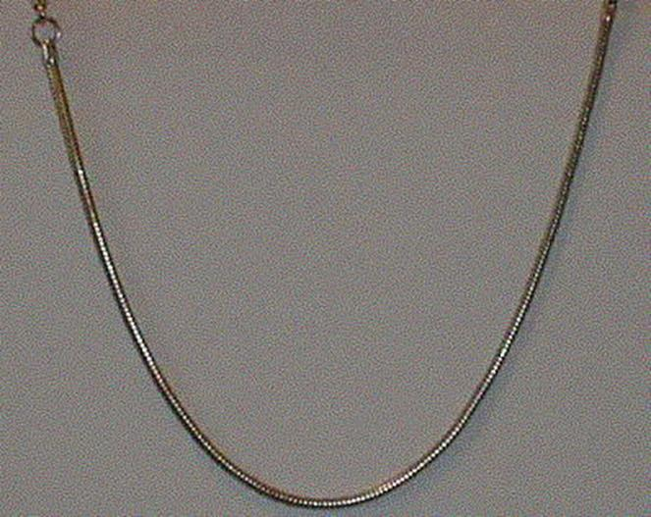

Slide 37
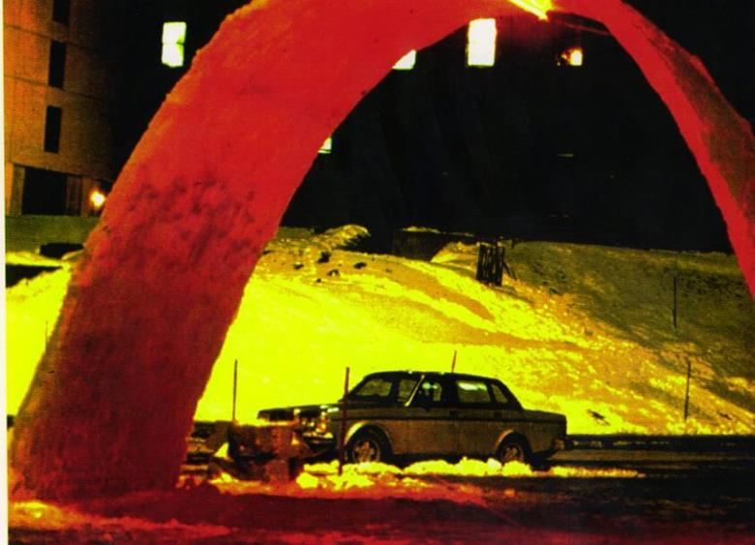

Slide 38
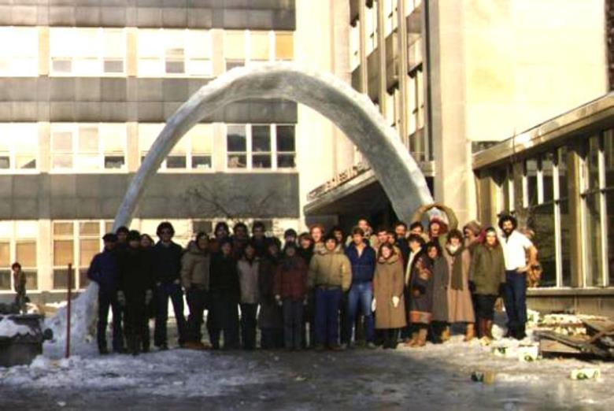

Slide 39


Slide 40

The plan: 1/5 scale=1/25area=1/125 volume!

Slide 41

Top of the line 1996 3D digital model..

Slide 42



Use of ancient pise method for construction for two ancient reasons: repeat form use and high thermal mass

Slide 43


In the Pantheon: curvature of the walls = curvature of the dome

Slide 44


No time for sculptured finishes!

Slide 45


Slide 46

Japanese have recently done research on long-span domes up to 25 m in span

Slide 47


Fuksas ‘Blob’ building in Eindhoven Holland

Slide 48


Technical University Eindhoven has built the first 30 m span dome using pykrete

Slide 49



This year’s effort to build a symbolic 30 m high model of the Sagrada Familia

Slide 50

Part two: ice rapid prototyping in our McGill lab

